Slide 1


Rockbuster Stealth, LLC
Data Dictionary
Nancy Kolaski
4/16/24

Slide 2
Table of contents:
3- Rockbuster ERD --------------------------------------------------------------------------------------------------------------------------------------------------------------------------------------------------4
FACT TABLES:
Payment---------------------------------------------------------------------------------------------------------------------------------------------------------------------------------------------------------------4
Rental -----------------------------------------------------------------------------------------------------------------------------------------------------------------------------------------------------------------4
DIMENSION TABLES:
Actor-------------------------------------------------------------------------------------------------------------------------------------------------------------------------------------------------------------------4
Address---------------------------------------------------------------------------------------------------------------------------------------------------------------------------------------------------------------5
Category ------------------------------------------------------------------------------------------------------------------------------------------------------------------------------------------------------------5
City. -------------------------------------------------------------------------------------------------------------------------------------------------------------------------------------------------------------------5
Country----------------------------------------------------------------------------------------------------------------------------------------------------------------------------------------------------------------5
Customer--------------------------------------------------------------------------------------------------------------------------------------------------------------------------------------------------------------6
Film---------------------------------------------------------------------------------------------------------------------------------------------------------------------------------------------------------------------6
Film_actor-------------------------------------------------------------------------------------------------------------------------------------------------------------------------------------------------------------6
Film_category --------------------------------------------------------------------------------------------------------------------------------------------------------------------------------------------------------7
Inventory --------------------------------------------------------------------------------------------------------------------------------------------------------------------------------------------------------------7
Language--------------------------------------------------------------------------------------------------------------------------------------------------------------------------------------------------------------7
Staff---------------------------------------------------------------------------------------------------------------------------------------------------------------------------------------------------------------------7
Store--------------------------------------------------------------------------------------------------------------------------------------------------------------------------------------------------------------------8
Primary Key
Foreign Key

Slide 3
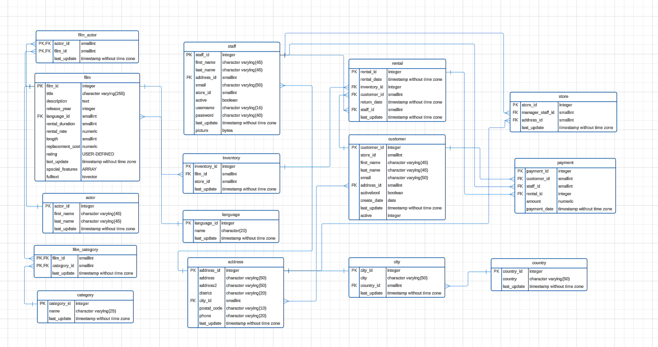
Rockbuster ERD (Entity Relationship Diagram)

Slide 4
Fact Tables:
Payment
payment
Columns | Data Type | Description
Payment_id | Serial | Primary key, Number to identify payment
Customer_id | Smallint | Number to identify customer, foreign key to customer table
Staff_id | Smallint | Number to identify staff member, foreign key to staff table
Rental_id | Integer | Number to identify the rental(film), foreign key to rental table
Amount | numeric | Cost of the film
Payment_date | Timestamp | Date for when the payment was made
Rental
rental
Columns | Data Type | Description
Rental_id | Serial | Primary key, number to identify the rental
Rental_date | Timestamp | Date of rental
Inventory_id | Integer | Number to identify inventory(film), foreign key to inventory table
Customer_id | Smallint | Number to identify customer, foreign key to customer table
Return_date | Timestamp | Date when film was returned
Staff_id | Smallint | Number to identify staff, foreign key to staff table
Last_update | Timestamp | Date for when record was last updated (YYYY-DD-MM)
Dimension Tables
Actor
actor
Columns | Data Type | Description
Actor_id | Serial | primary key to Identify each actor
First_name | varchar | First name of actor
Last_name | Varchar | Last name of actor
Last_update | Timestamp | Date for when the record was updated last (YYYY-DD_MM)

Slide 5
Dimension Tables, cont’d
Address
address
Columns | Data Type | Description
Address_id | Serial | Primary key, number to identify the address in the table
Address | Character varying(50) | Line 1 of address (max of 50 characters)
Address2 | Character varying(50) | Line 2 of address (max of 50 characters)
District | Character varying (20) | District’s address (max of 20 characters)
City_id | Smallint | Number to identify the city, foreign key to city table
Postal_code | Character varying (10) | Postal code portion of address (max of 10 characters)
Phone | Character varying (20) | Phone number that belongs to address (max 20 characters)
Last_update | Timestamp | Date for when record was last updated (YYYY-DD-MM)
Category
category
Columns | Data Type | Description
Category_id | Serial | Primary key, number used to identify category of the film
Name | Character varying (25) | Name of category (max of 25 characters)
Last_update | timestamp | Date for when the record was updated last (YYYY-DD_MM)
City
city
Columns | Data Type | Description
City_id | Serial | Primary key, Number to identify the city
City | Character varying (50) | Name of city (max of 50 characters)
Country_id | Smallint | Number to identify the country, foreign key to country table
Last_update | Timestamp | Date for when record was last updated (YYYY-DD-MM)
Country
country
Columns | Data Type | Description
Country_id | Serial | Primary key, Number to identify the country
Country | Character varying (50) | Name of country (max of 50 characters)
Last_update | Timestampt | Date for when record was last updated (YYYY-DD-MM)

Slide 6
Dimension Table, cont’d
Customer
customer
Columns | Data Type | Description
Customer_id | Serial | Primary key, number to identify the customer
Store_id | Smallint | Number to identify the store, foreign key to store table
First_name | Character carrying (45) | Customer’s first name (max 45 characters)
Last_name | Character varying (45) | Customer’s last ame (max 45 characters)
Email | Character varying (50) | Customer’s email (max 50 characters)
Address_id | Smallint | Customer’s address, foreign key to address table
Activebool | Boolean | True, false, or null statement for customer’s status
Create_date | Date | Date when the customer’s account was created
Active | Integer | Number to identify if the account is active
Film
Film
Columns | Data Type | Description
Film_id | Serial | Primary key to identify each film
Title | varchar | Title of the film
Description | text | Description of the film
Release year | Year | Year of film release
Language_id | Integer | Language, foreign key to language table
Rental_duration | integer | Duration of the rental
Rental_rate | numeric | Rental fee
Length | integer | Length of the film
Replacement_cost | numeric | Cost for film replacement
rating | ARRAY | Film rating
Last_update | Timestamp | Date of when the record was updated last (YYYY-DD-MM)
Special_features | Text | Special features of the film
Fulltxt | tsvector
Film_actor
Film_actor
Columns | Data Type | Description
actor_id | Smallint | Composite key, to identify each actor, foreign key to actor table
film_id | Smallint | Composite key, to identify each film, foreign key to film table
last_update | Timestamp without time zone | Date of when the record was updated last (YYYY-DD-MM)

Slide 7
Dimension Tables, cont’d
Film_category
film_category
Columns | Data Type | Description
Film_id | Smallint | Composite key to identify each film category and foreign key to film table
Category_id | Smallint | Composite primary key to identify each film category, foreign key to category table
Last_update | Timestamp | Date for when the record was updated last (YYYY-DD_MM)
Inventory
inventory
Columns | Data Type | Description
Inventory_id | Serial | Primary key, used to identify the film’s inventory number
Film_id | Smallint | Number to identify each film, foreign key to film table
Store_id | Smallint | Number to identify the store, foreign key to store table
Last update | Timestampt | Date for when the record was updated last (YYYY-DD_MM)
Language
language
Columns | Data Type | Description
Language_id | Serial | Primary key, number to identify the language in the film
Name | Character (20) | Name of the language in the film (max 20)
Last_update | Timestamp | Date for when the record was updated last (YYYY-DD-MM)
Staff
staff
Columns | Data Type | Description
Staff_id | Serial | Primary key, identifying the staff members
First_name | Character varying (45) | Staff’s first name (max 45 characters)
Last_name | Character varying (45) | Staff’s last name (max 45 characters)
Address_id | Smallint | Staff’s address, foreign key to address table
Email | Character varying (50) | Staff’s email (max 50 characters)
Store_id | Smallint | Number used to identify the store
Active | Boolean | True, false, or null statement to imply active status of staff
Username | Character varying (16) | Staff member’s username (max of 16 characters)
Password | Character varying (40) | Staff member’s password (max of 40 characters)
Last_update | Timestamp | Date for when the record was updated last (YYYY-DD_MM)
Picture | bytea | Binary data in form of pictures/images/audio files

Slide 8
Dimension Tables, cont’d
Store
store
Columns | Data Type | Description
Store_id | Serial | Primary key, number to identify the store
Manager_staff_id | Smallint | Number to identify the manager, foreign key to staff table
Address_id | Smallint | Number of address, foreign key to address table
Last_update | Timestamp | Date for when record was last updated (YYYY-DD-MM)

